Slide 1
Garden Planting Plan Optimization: Maximizing bed usage & visualizing species distribution
Date: 6 May 2025 By: Tahidul, Daniel, and Fred
COMPUTATIONAL OPERATIONS RESEARCH MATH/CSCI 4320/8326, Spring 2025, UNO

Slide 2
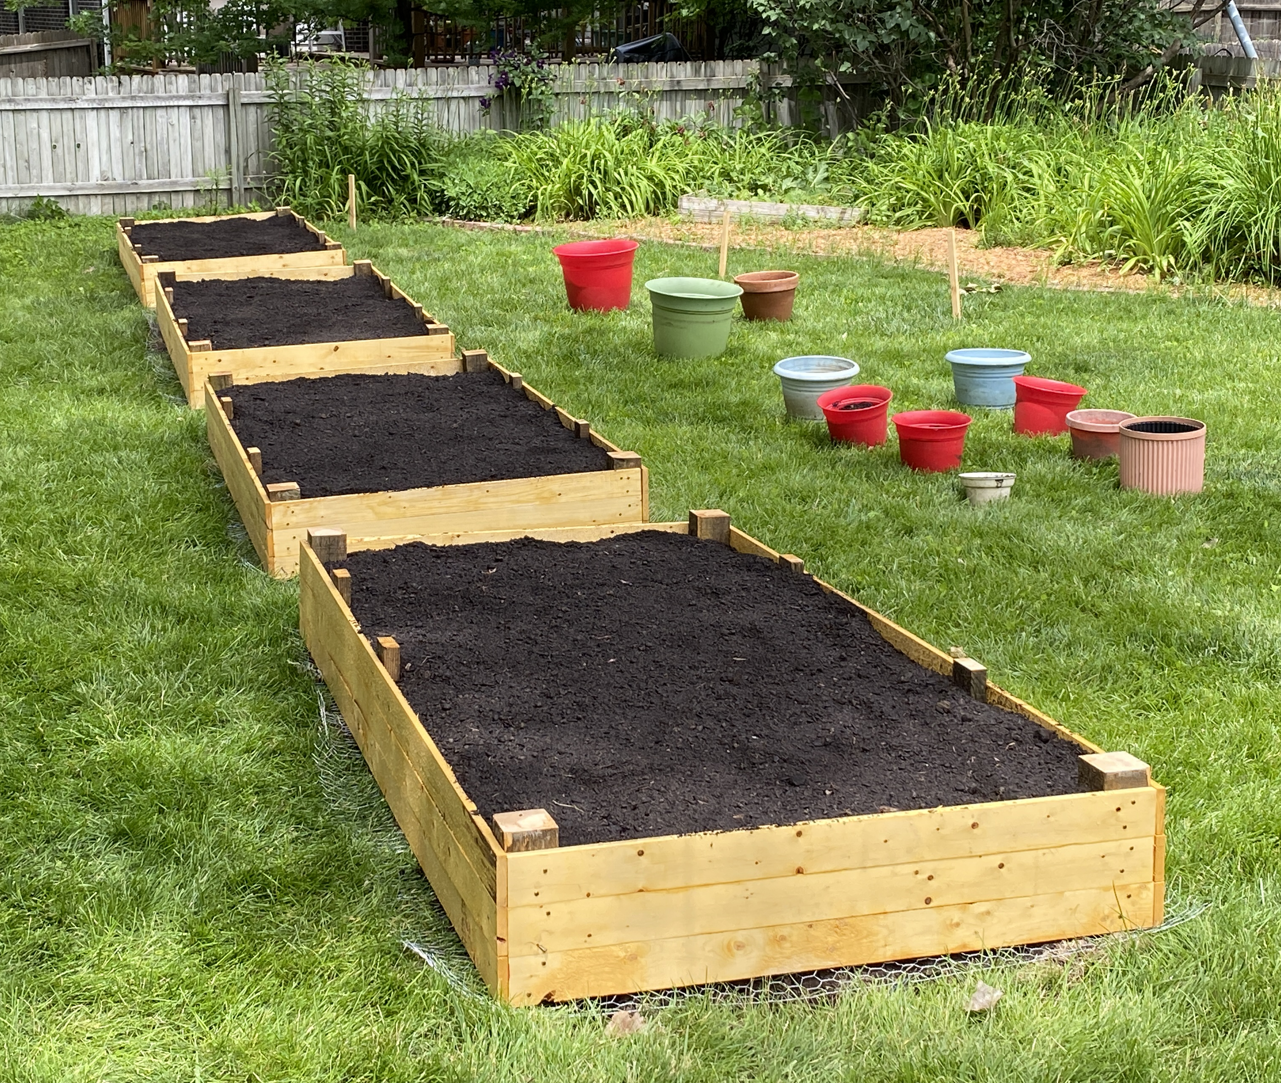
Why optimize a vegetable garden?
Daniel will put picture of his garden
Rising Food Prices – Stretch budget by growing produce
Poor Diet & Nutrition – Boost fresh vegetable intake and nutrients
Sedentary Lifestyles – Add gentle daily activity through planting & upkeep
Backyard Gardens = Triple Win – Save money, eat healthier, move more
But… Most Beginners Struggle – What to plant, when, where, and how much?
Optimization Is Key – Data‐driven planning ensures every square foot counts
Notes:
Problem: In recent years, food prices have been on the rise, nutrition of the Average American diet has continued to be poor, and people continue a sedentary lifestyle. As a method to combat all three of these issues, starting a backyard food garden would help improve the overall health of Americans. However, most people don't really know what they are doing and how best to start a garden while keeping in mind how to manage supplying a healthy diet.

Slide 3

Project Goal Pack four 4 × 8 ft beds to meet our 2025 crop plan while obeying spacing & preference rules.
Fulfill 2025 Planting Requirements
Maximize Use of Garden Beds
Adhere to Special Plant Rules
Leverage Optimization
Deliver Clear Visualizations
Produce a Ready-to-Use Plan
Notes:
Daniel will talk about its real personal/gardening use‑case

Slide 4
Overview of Data
Names | Min | Max | Exact | Spacing | Plant Height | 2025? | One per bed? | All in one bed?
Bell Pepper | 4 | 16 | - | 12 - 18" | - | Yes | No | No
Carrot | - | - | - | 12" | - | No | No | No
Cucumber | - | - | - | 36" | - | No | No | No
Beds | Width(ft) | Length(ft)
A | 4 | 8
B | 4 | 8
C | 4 | 8
D | 4 | 8
Each bed = (4ft×8ft)
Area per bed = 4608in²
(+13 more crops in full table)
16 total crops, spacing from 3 inch to 48 inch
Bed A
Bed B
Bed C
Bed D

Slide 5
Key Data Columns
Variables | Description
Name | Plant name
Min Required, Max Required, Exact | Quantity constraints
Plant in 2025 | Yes/No flag
One per bed? | 1 plant in each bed if Yes
All in one bed? | All plants in a single bed if Yes
Spacing Between Plants | e.g. "12–18" parsed to min/max

Slide 6
Mathematical Formulation
Decision Variables
Objective Function
Constraints

Slide 7
Decision Variables
Let:

Slide 8
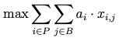
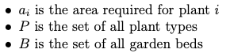
Objective Function
Where:

Slide 9
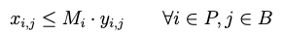
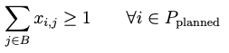
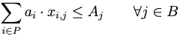
Constraints (1 of 3)

Slide 10
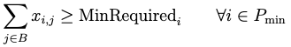
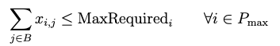
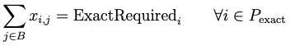
Constraints (2 of 3)

Slide 11
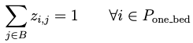
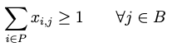
Constraints (3 of 3)

Slide 12


Slide 13
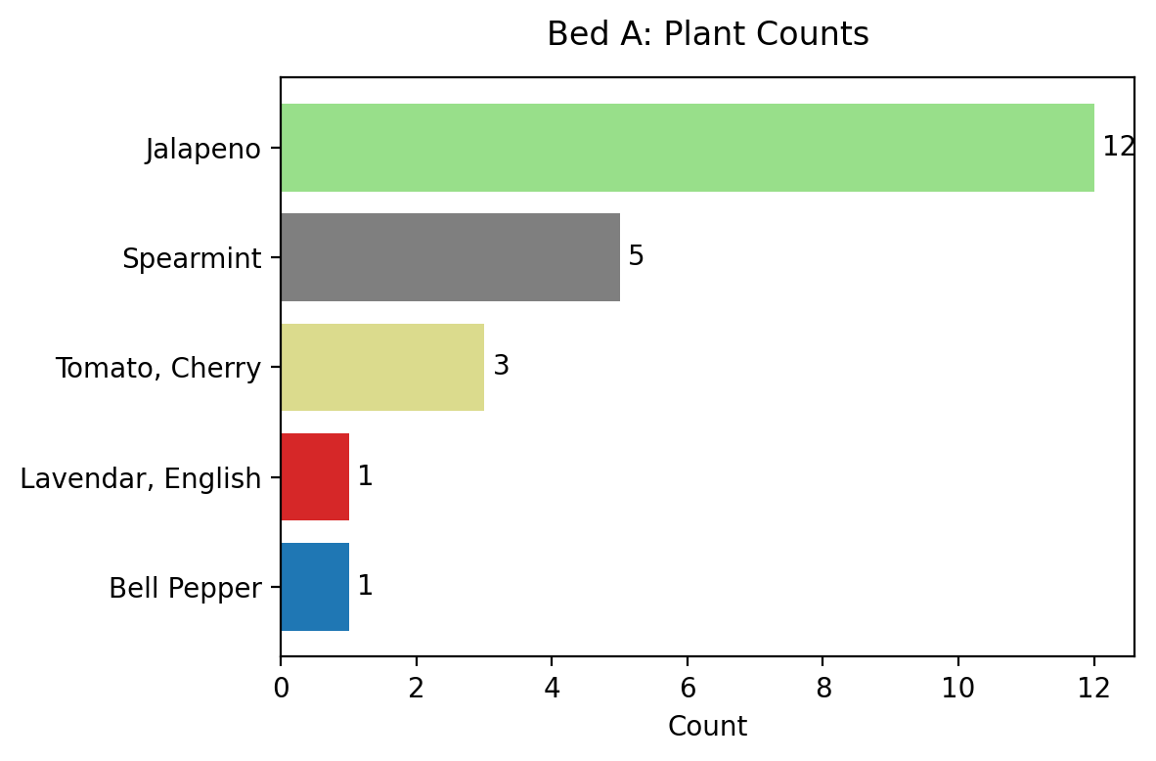
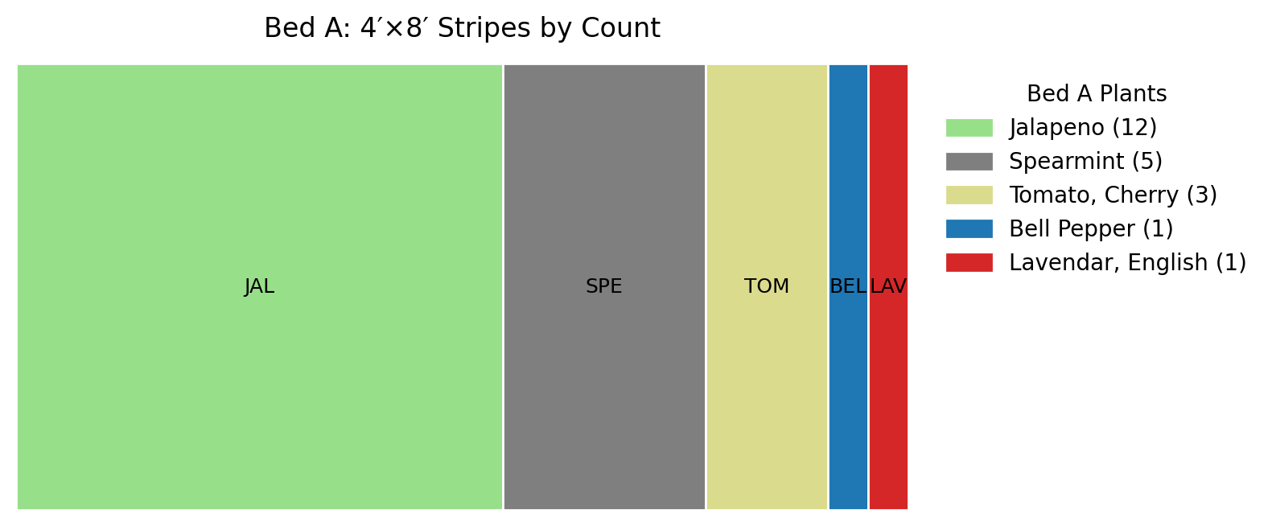
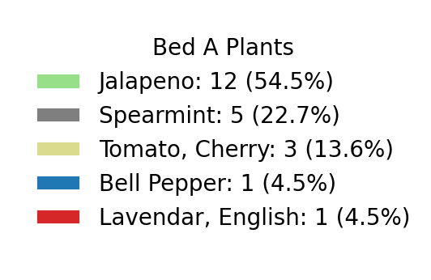
Bed A
Number of Plants
Bed Layout

Slide 14
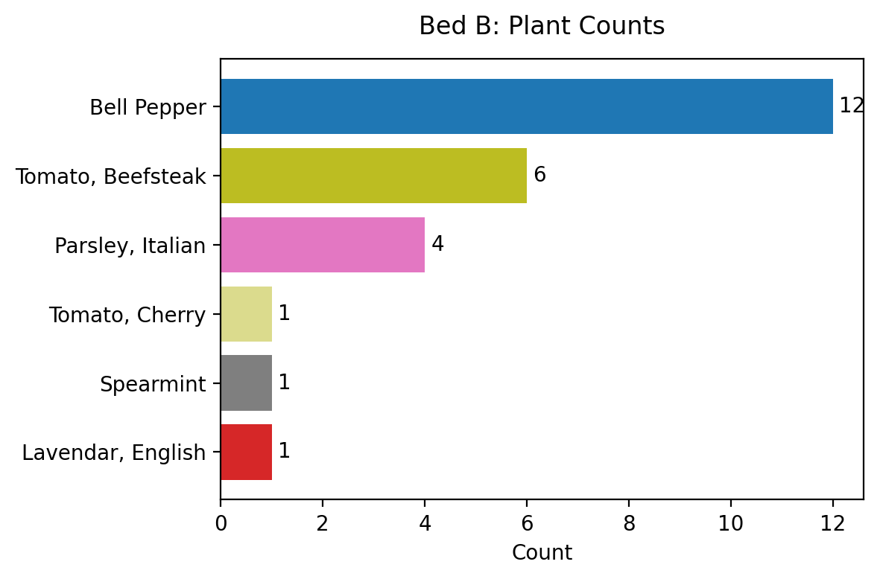
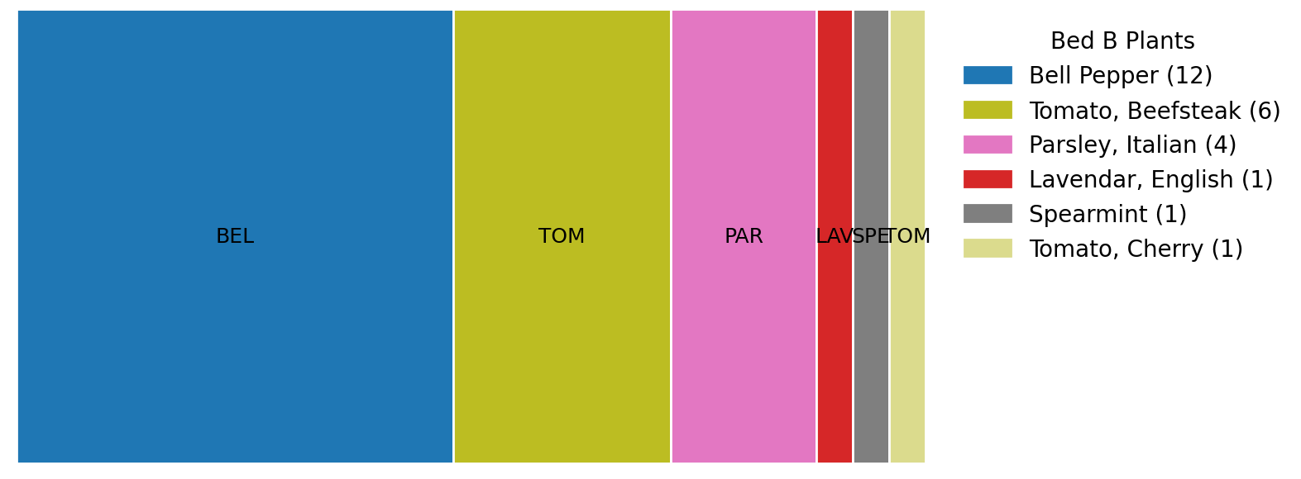
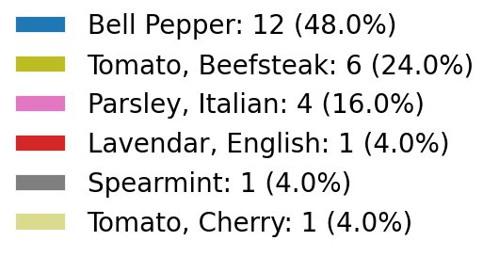
Bed B
Number of Plants
Bed Layout

Slide 15
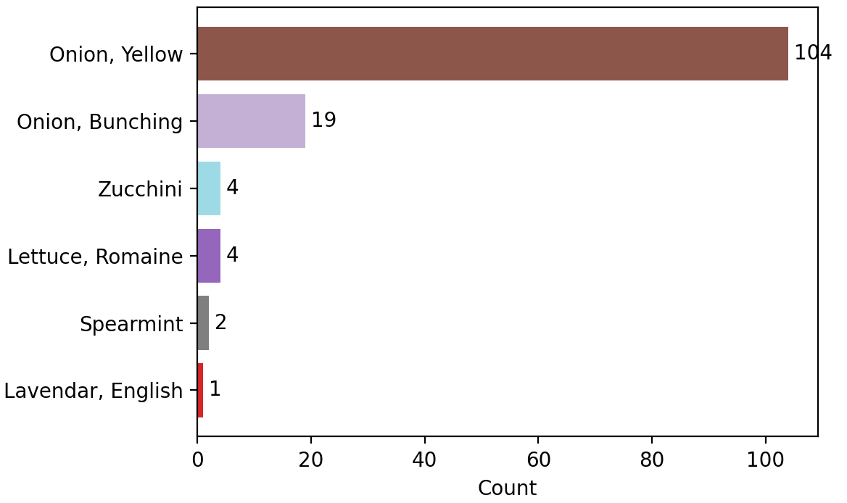
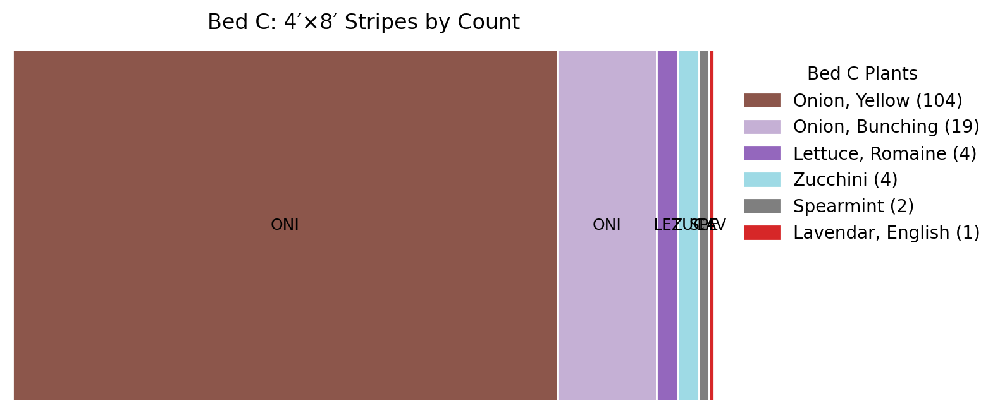
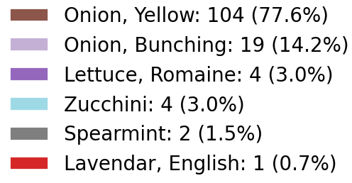
Bed C
Number of Plants
Bed Layout
5 sq inch is unused

Slide 16
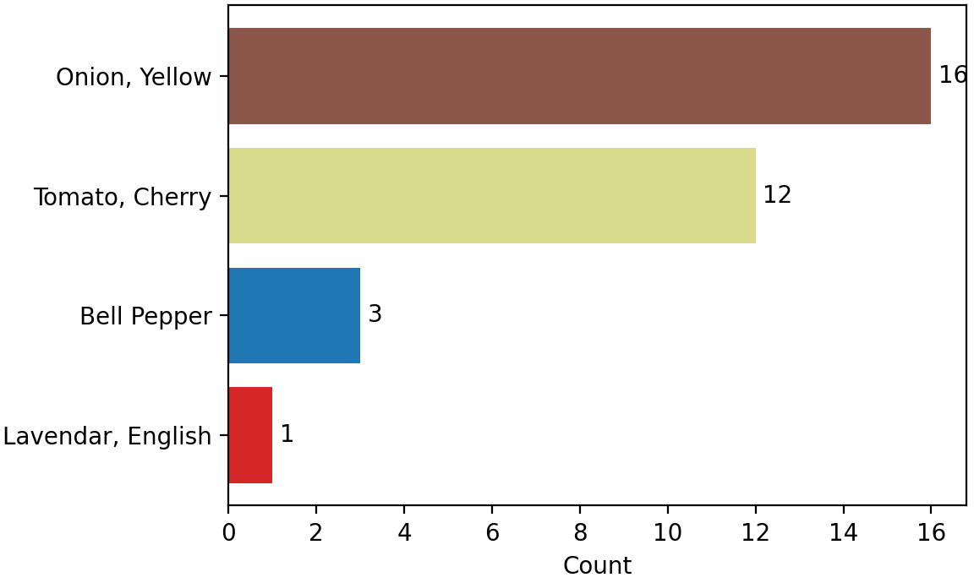
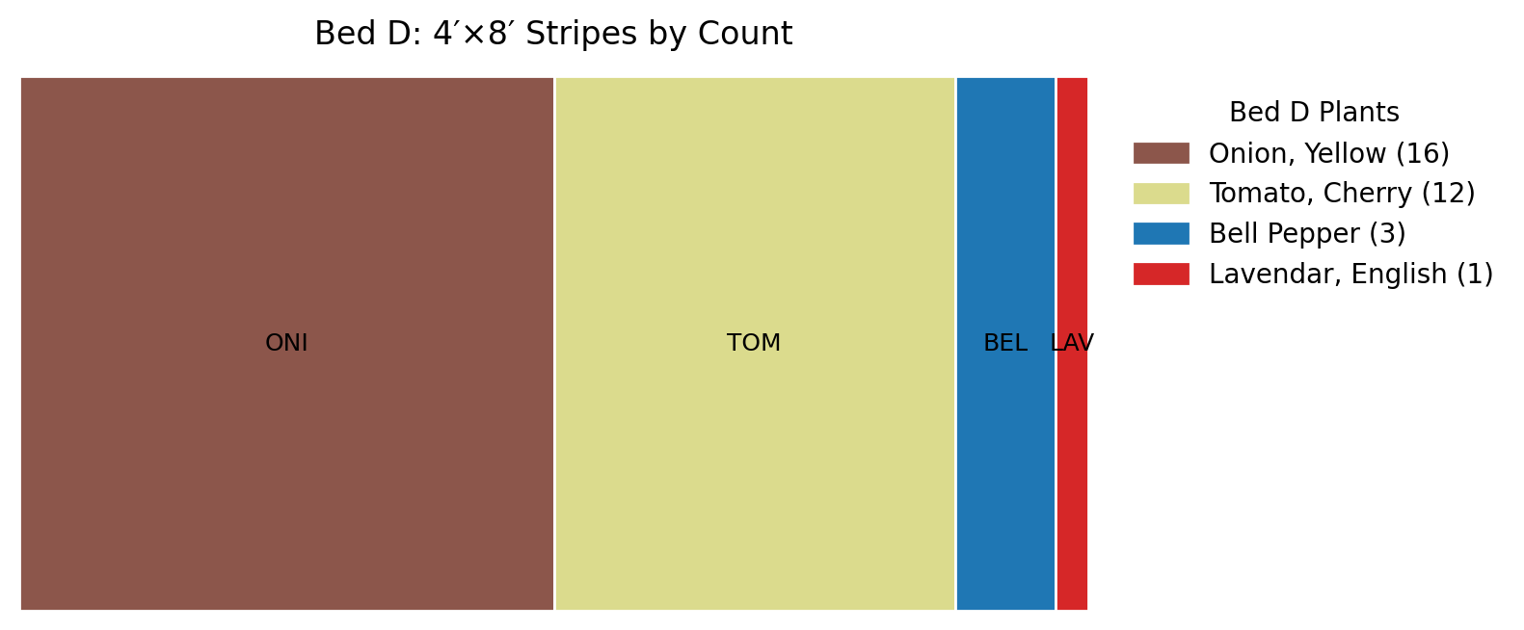
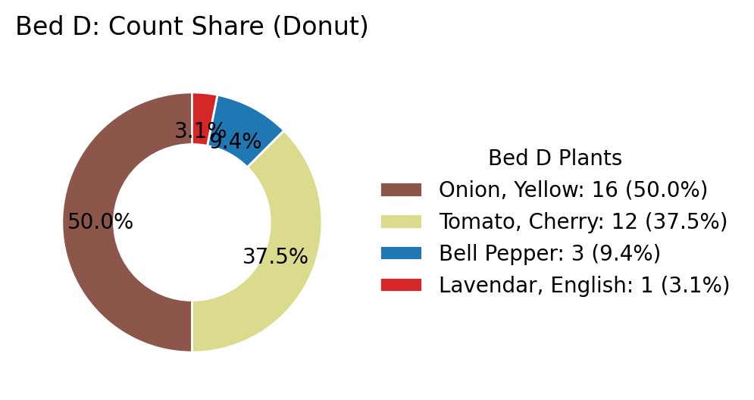
Bed D
Number of Plants
Bed Layout

Slide 17

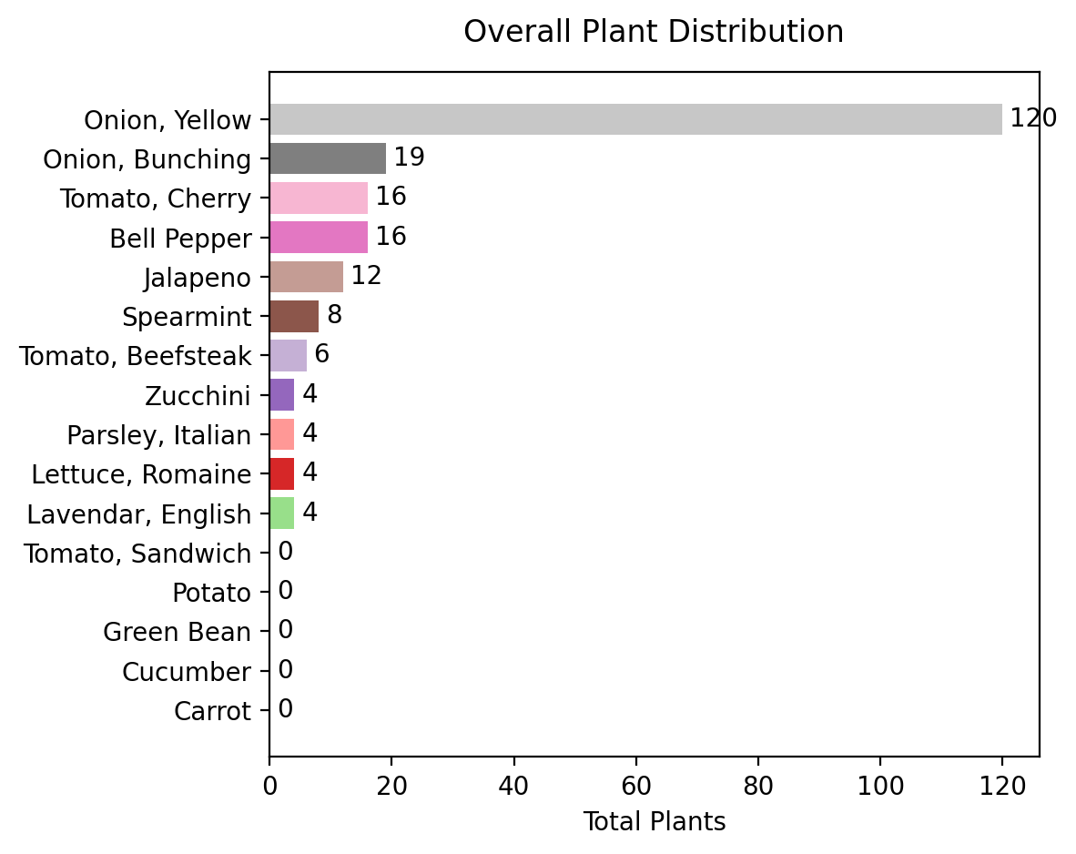
Summary
Our model uses 68 variables and 52 constraints
Bed | Plants | Used Area (in²) | Capacity (in²)
A | 22 | 4608 | 4608
B | 25 | 4608 | 4608
C | 134 | 4603 | 4608
D | 32 | 4608 | 4608
All beds are essentially maximized—only Bed C has 5 in² slack (< 0.1 %).

Slide 18
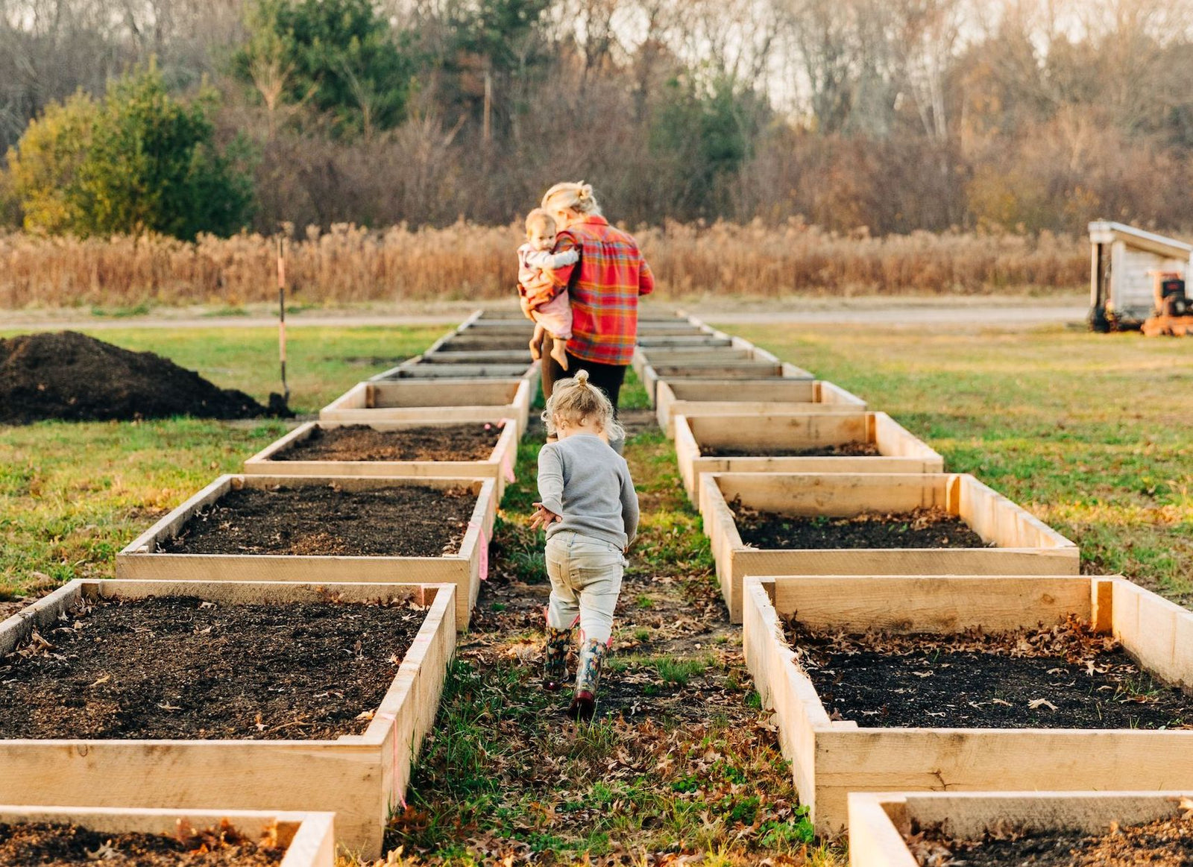
Future Directions
Yield & Profit Modeling
Multi‐Season Crop Rotation
Good and Bad Neighbour Rules
Geospatial & Scale‐Up
Real‐Time Sensor & IoT Integration
Multi‐Objective Optimization

Slide 19
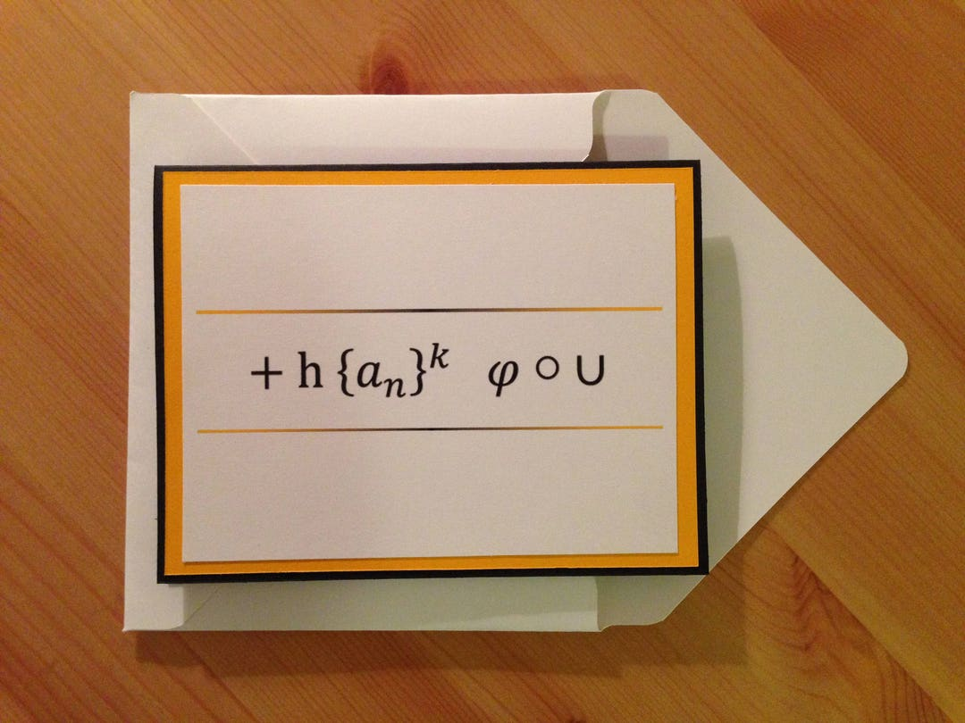
Heartfelt thanks to Professor Fabio—for planting the spark of innovation in our minds and helping each of us grow into confident optimization problem-solvers.

Slide 20


